Slide 1
BUSINESS RESEARCH METHODS
Instructor: Dr. Sambashiva Rao
School of Management
National Institute of Technology, Rourkela

Slide 2
Rules and regulations
Mic should be mute during class-room.
Videos may be off.
Submission of assignments on time.

Slide 3




Why Business Research for engineers?
Model X
Elon Reeve Musk
Apple iPhone
Eye trackers

Slide 4

Vaccine Status?
Available

Slide 5



Gap
Product/Service Customer Expectations
Product
Price
Promotion
Place and much more

Slide 6
Unit-I
Research: –
Definition, Meaning, Importance types and Qualities of Research , applications in functional areas of Business, Emerging trends in Business research.
Research & the Scientific Method: Characteristics of scientific method.
Steps in Research Process Concept of Scientific Enquiry: – Formulation of Research Problem – Management Question – research Question – Investigation Question

Slide 7


Slide 8
Questions?
COVID-19 started from Wuhan Lab?
What is the alternative of Xiomi?
When Indian economy will revamp?
What will be job opportunities?

Slide 9
What is research?
Finding answers to the questions.
Systematic search for truth
Finding new and original information, ideas about the world we live in, are obtained (Can we make vaccines)
Search for knowledge (Stock Market).
Scientific and systematic search for information on a specific topic.
Notes:
9

Slide 10
What is research?
An art of scientific investigation.
The Advanced Learner’s Dictionary of Current English lays down the meaning of research as “a careful investigation or inquiry specially through search for new facts in any branch of knowledge.”

Slide 11
DEFINITION OF RESEARCH
• Redman and Mory “Systematized effort to gain new knowledge”
• According to Clifford Woody research comprises defining and redefining problems, formulating hypothesis or suggested solutions; collecting, organising and evaluating data; making deductions and reaching conclusions; and at last carefully testing the conclusions to determine whether they fit the formulating hypothesis.

Slide 12
Which of these can be classified as research?
[1] Samad prepared a paper on “computer usage in secondary schools” after reviewing literature on the subject available in his university library.
[2] Manoj says that he has researched and completed a document which gives information about the age of his students, their results, their parents income and distance of their schools from the District Office.
[3] Kim participated in a workshop on curriculum development and prepared what he calls, a report on the curriculum for Engineers.

Slide 13
None of the above examples can be classified under the name research.

Slide 14


Consider the following case which is an example of research
•A general manager of a car producing company was concerned with the complaints received from the car users that the car they produce have some problems with sound at the dash board and the rear passenger seat after few thousand kilometers of driving.
•He obtained information from the company workers to identify the various factors influencing the problem.
•He then formulated the problem and generated guesses (hypotheses).
•He constructed a checklist and obtained requisite information from a representative sample of cars.
•He analyzed the collected data, interpreted the results in the light of his hypotheses and reached conclusions.

Slide 15
• Research is systematic, because it follows certain steps that are logical in order. These steps are:
1. Understanding the nature of problem to be studied and identifying the related area of knowledge.
2. Reviewing literature to understand how others have
approached or dealt with the problem.
3. Collecting data in an organized and controlled manner so as to arrive at valid decisions.
4. Analyzing data appropriate to the problem.
5. Drawing conclusions and making generalizations.

Slide 16
OBJECTIVES OF RESEARCH
1. To gain familiarity with a phenomenon or to achieve new insights into it (studies with this object in view are termed as exploratory research studies).
2. To portray accurately the characteristics of a particular individual, situation or a group (studies with this object in view are known as descriptive research studies).
3. To determine the frequency with which something occurs or with which it is associated with something else (studies with this object in view are known as diagnostic research studies)
4. To test a hypothesis of a causal relationship between variables (such studies are known as hypothesis-testing research studies).

Slide 17

MOTIVATION IN RESEARCH
1. Desire to get a research degree along with its consequential benefits;
2. Desire to face the challenge in solving the unsolved problems, i.e., concern over practical problems initiates research;
3. Desire to get intellectual joy of doing some creative work;
4. Desire to be of service to society;
5. Desire to get respectability

Slide 18

Types of research?
The basic type of research as follows:
Descriptive vs. Analytical:
Applied vs. Fundamental:
Quantitative vs. Qualitative:
Conceptual vs. Empirical:
Some Other Types of Research:

Slide 19
Descriptive vs Analytical:
Descriptive research includes surveys and fact-finding enquiries of different kinds.
The major purpose of descriptive research is description of the state of affairs as it exists at present.
Ex post facto research for descriptive research studies.
The main characteristic of this method is that the researcher has no control over the variables; he can only report what has happened or what is happening.
Most ex post facto research projects are used for descriptive studies in which the researcher seeks to measure such items as, for example, frequency of shopping, preferences of people, or similar data.

Slide 20
Ex post facto studies also include attempts by researchers to discover causes even when they cannot control the variables.
The methods of research utilized in descriptive research are survey methods of all kinds, including comparative and correlational methods.
In analytical research, on the other hand, the researcher has to use facts or information already available, and analyze these to make a critical evaluation of the material

Slide 21
Investigation starts after the fact has occurred without interference from the researcher.
test hypotheses about cause-and-effect relationships or in situations
1. One commences with subjects who differ on an independent variable, for example their years of study in mathematics, and then study how they differ on the dependent variable, e.g. a mathematics test.
2. One commences with subjects who differ on the dependent variable (for example their performance in a mathematics test) and discover how they differ on a range of independent variables, e.g. their years of study, their liking for the subject, the amount of homework they do in mathematics

Slide 22
Applied vs. Fundamental:
Research can either be applied (or action) research or fundamental (to basic or pure) research.
Applied research aims at finding a solution for an immediate problem facing a society or an industrial/business organisation,
where as fundamental research is mainly concerned with generalisations and with the formulation of a theory.
“Gathering knowledge for knowledge’s sake is termed ‘pure’ or ‘basic’ research.”

Slide 23
Continue..
Research concerning some natural phenomenon or relating to pure mathematics are examples of fundamental research.
The central aim of applied research is to discover a solution for some pressing practical problem
whereas basic research is directed towards finding information that has a broad base of applications and thus, adds to the already existing organized body of scientific knowledge.

Slide 24
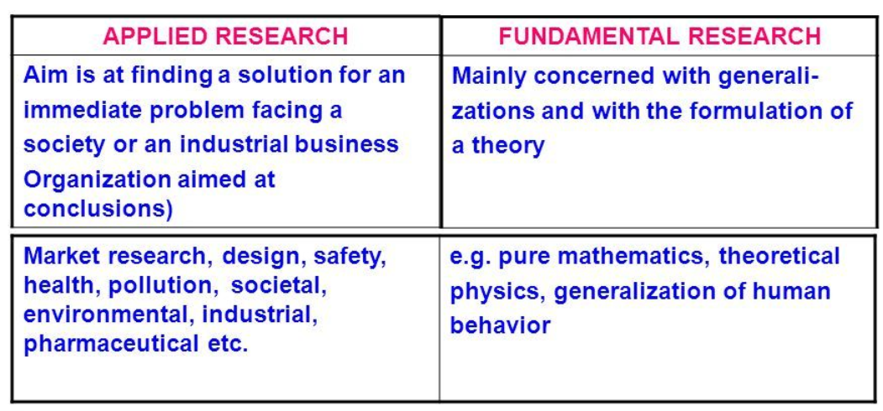
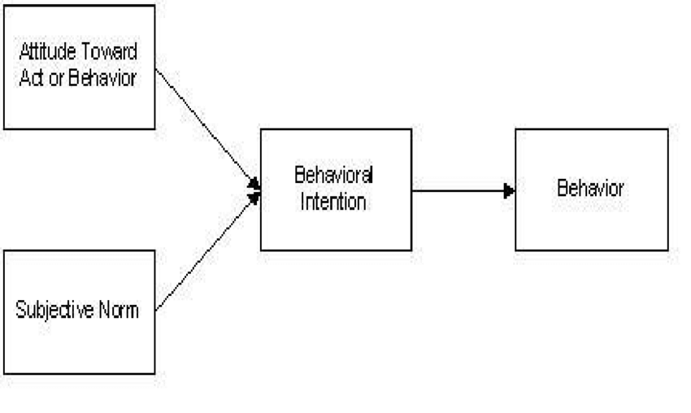

Slide 25
Quantitative vs. Qualitative:
Quantitative research is based on the measurement of quantity or amount. It is applicable to phenomena that can be expressed in terms of quantity.
Qualitative research, on the other hand, is concerned with qualitative phenomenon, i.e., phenomena relating to or involving quality or kind. For instance, when we are interested in investigating the reasons for human behaviour (i.e., why people think or do certain things),

Slide 26
Quantitative research is expressed in numbers and graphs. It is used to test or confirm theories and assumptions.
This type of research can be used to establish generalizable facts about a topic.
Common quantitative methods include experiments, observations recorded as numbers, and surveys with closed-ended questions.
Qualitative research is expressed in words. It is used to understand concepts, thoughts or experiences.
This type of research enables you to gather in-depth insights on topics that are not well understood.
Common qualitative methods include interviews with open-ended questions, observations described in words, and literature reviews that explore concepts and theories.

Slide 27
Conceptual vs. Empirical
Conceptual research is that related to some abstract idea(s) or theory.
It is generally used by philosophers and thinkers to develop new concepts or to reinterpret existing ones.
On the other hand, empirical research relies on experience or observation alone, often without due regard for system and theory.
It is data-based research, coming up with conclusions which are capable of being verified by observation or experiment
Empirical research is appropriate when proof is sought that certain variables affect other variables in some way.
Evidence gathered through experiments or empirical studies is today considered to be the most powerful support possible for a given hypothesis.

Slide 28
Aristotle, Copernicus, Galileo, Newton and Einstein: these famous philosophers and scientists relied heavily on conceptual research to develop insight and theories about the way the world works.
They established concepts to explain common occurrences by observing their surroundings and compiling, studying and summarizing existing information.
Plato asked conceptual questions such as "What is justice?" as the basis of philosophy. The statements, "That action is wrong," or, "Knowledge is justified true belief," are conceptual claims.
Empirical research, on the other hand, is based not only on theory, but on experimentation. Using either a quantitative or qualitative methodology, researchers gather data that can be measured according to a certain population, place and/or time. They then use this information to make meaningful, fact-based conclusions.

Slide 29
Other types
One-time research or longitudinal research.
Field-setting research or laboratory research
Clinical or diagnostic research
Historical research is that which utilizes historical sources like documents, remains, etc.

Slide 30
Qualities of good research
Purpose clearly defined.
Research process detailed.
Research design thoroughly planned.
High ethical standards applied.
Limitations frankly revealed.
Adequate analysis for decision maker’s needs.
Findings presented clearly.
Conclusions justified.
Researcher’s experience reflected.

Slide 31
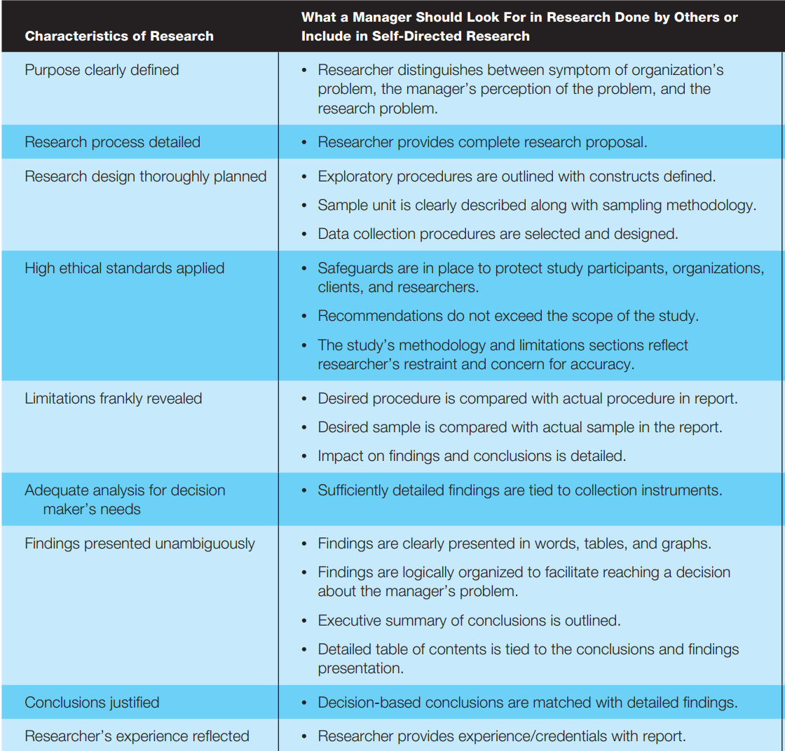

Slide 32
Applications in functional areas of Business

Slide 33
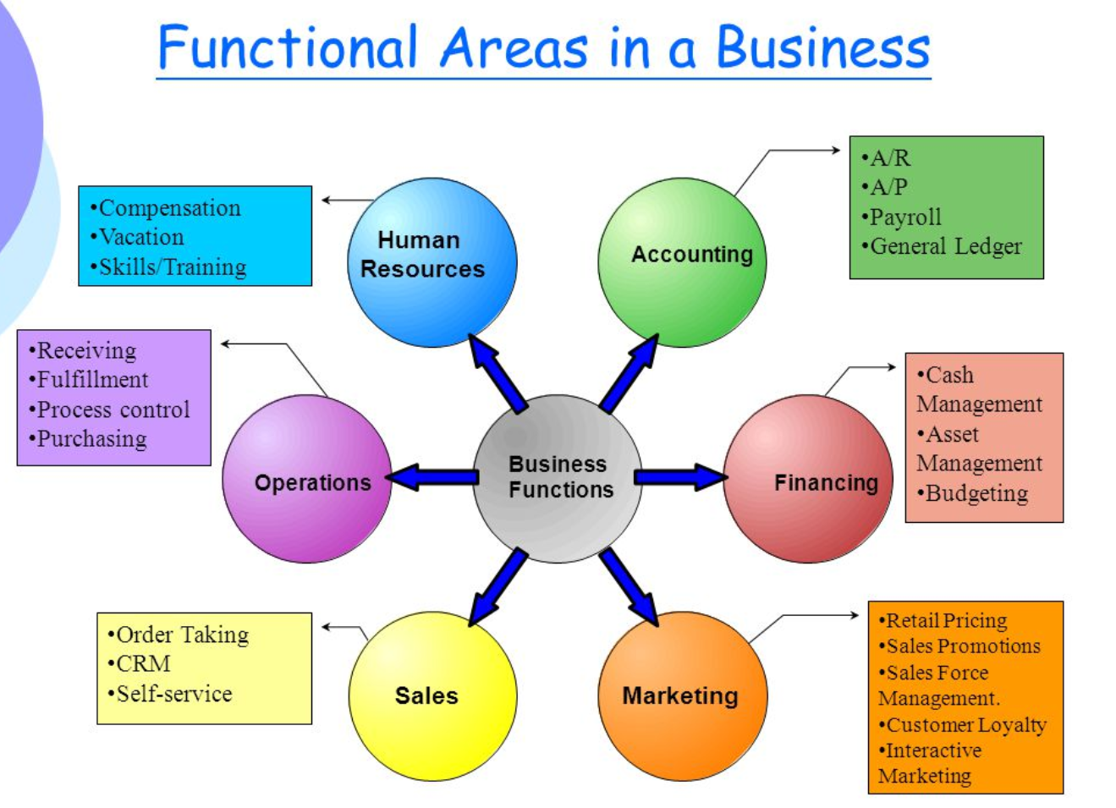

Slide 34
Human Resource
Marketing/Promotion
Production
Sales
Customer Service Support
Accounting and Finance etc.

Slide 35
Fields Where Research is Often Used
General Business Conditions and
Corporate Research
Short- & Long-Range Forecasting,
Business and Industry Trends
Global Environments
Inflation and Pricing
Plant and Warehouse Location
Acquisitions
Financial and Accounting Research
Forecasts of financial interest rate trends,
Stock,bond and commodity value predictions
Capital formation alternatives
Mergers and acquisitions
Risk-return trade-offs
Portfolio analysis
Impact of taxes
Research on financial institutions
Expected rate of return
Capital asset pricing models
Credit risk
Cost analysis
Management and Organizational
Behaviour Research
Total Quality Management
Morale and Job Satisfaction
Leadership Style
Employee Productivity
Organizational Effectiveness
Structural issues
Absenteeism and turnover
Organizational Climate

Slide 36
Fields Where Business Research is Often Used
Information Systems Research
Knowledge and information needs assessment
Computer information system use and evaluation
Technical suppot satisfaction
Database analysis
Data mining
Enterprise resource planning systems
Customer relationship management systems
Corporate Responsibility Research
Ecological Impact
Legal Constraints on advertising and promotion
Sex, age and racial discrimination / worker equity
Social values and ethics
Sales and Marketing Research
Market Potentials
Market Share
Market segmentation
Market characteristics
Sales Analysis
Establishment of sales quotas
Distribution channels
New product concepts
Test markets
Advertising research
Buyer behaviour
Customer satisfaction
Website visitation rates

Slide 37
Role of research in management

Slide 38
The Value of Business Research for Managers – (1)
Research is a systematic inquiry whose objective is to provide information to solve managerial problems.
Business Research Methods can be employed in each of the following four stages:
Identification of problems and/or opportunities
(2) Diagnosing and Assessment of problems and/or opportunities
(3) Selection and Implementation of Courses of Action
(4) Evaluating the Course of Action

Slide 39


Examples of Real-Life Situations in which Business Research Methods are used
A firm wants to produce and market a new product but first wants to ascertain if there is a potential consumer demand for this product in markets x, y and z
A multinational firm wants to establish a production facility in another country after determining its technical and economic feasibility

Slide 40

A government agency wants to ascertain the satisfaction level of its employees, the causes for any possible discontent, and propose a scheme for enhancing this level
A MNC wants to find out the trends in retail and wholesale sector

Slide 41
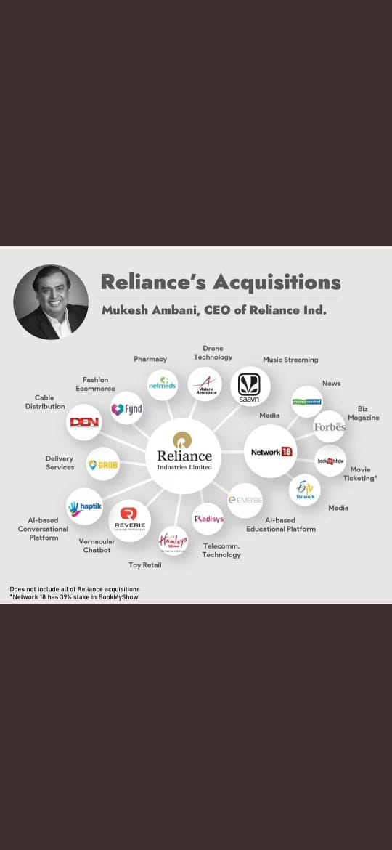

Slide 42
Research Methods versus Methodology
Research methods may be understood as all those methods/techniques that are used for conduction of research.
All those methods which are used by the researcher during the course of studying his research problem are termed as research methods.

Slide 43
Research methodology is a way to systematically solve the research problem. It may be understood as a science of studying how research is done scientifically.
In it we study the various steps that are generally adopted by a researcher in studying his research problem along with the logic behind them.
It is necessary for the researcher to know not only the research methods/techniques but also the methodology.

Slide 44
Research methods do constitute a part of the research methodology.
The scope of research methodology is wider than that of research methods.
why we are using a particular method or technique and
why we are not using others so that research results are capable of being evaluated either by the researcher himself or by others.

Slide 45
Why a research study has been undertaken
How the research problem has been defined, in what way and why the hypothesis has been formulated,
What data have been collected and what particular method has been adopted,
Why particular technique of analysing data has been used

Slide 46
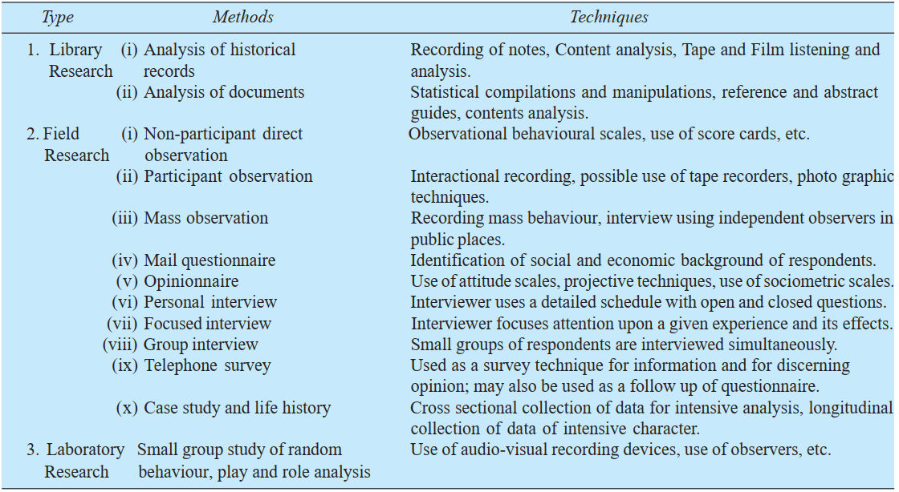

Slide 47
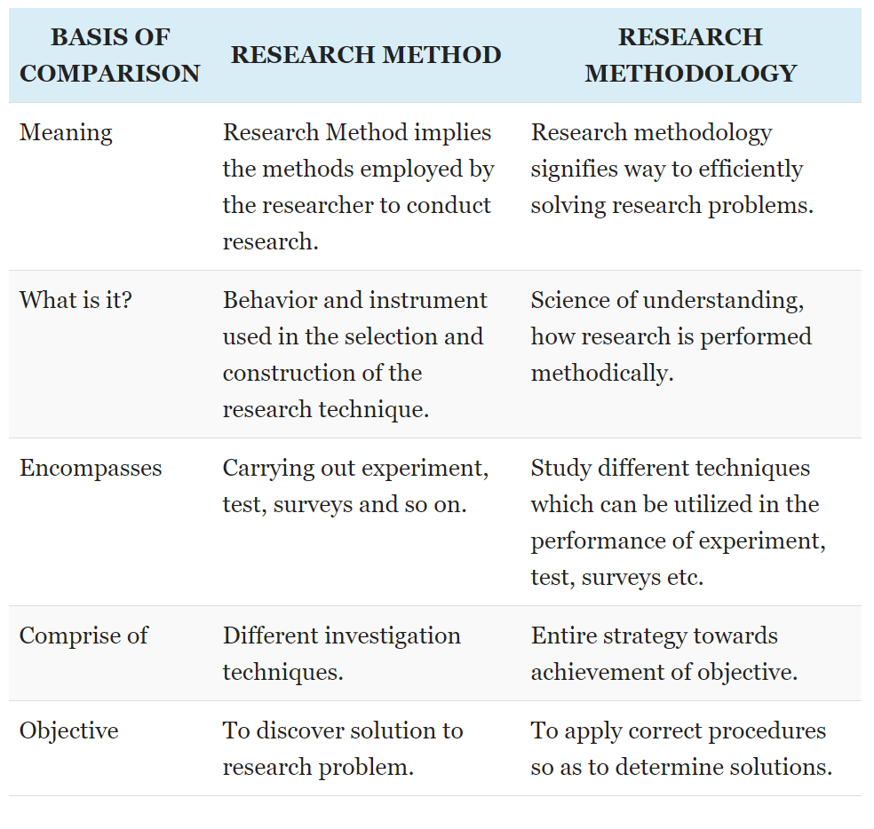

Slide 48
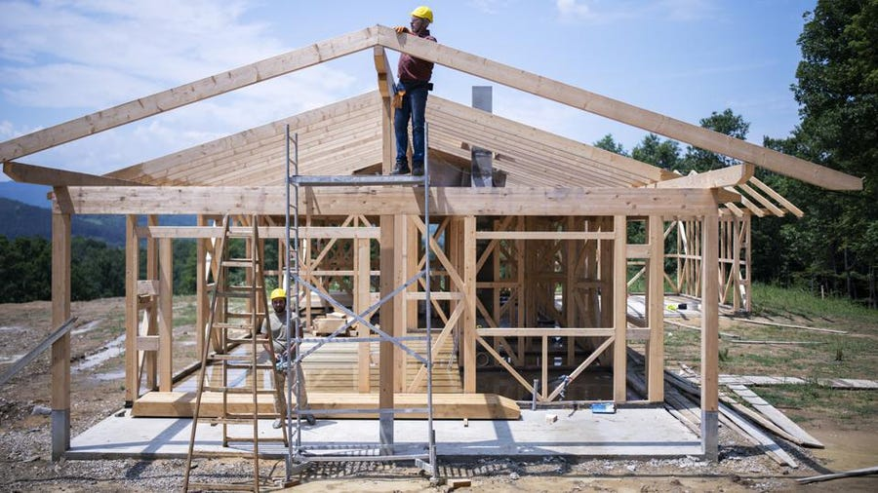
A simple analogy: building a house.
Research methods are the tools in the carpenter's toolbox.
Research methodology is the construction plans.

Slide 49
The scientific method: characteristics of scientific method.
Scientific method is the pursuit of truth as determined by logical considerations.
The ideal of science is to achieve a systematic interrelation of facts.

Slide 50
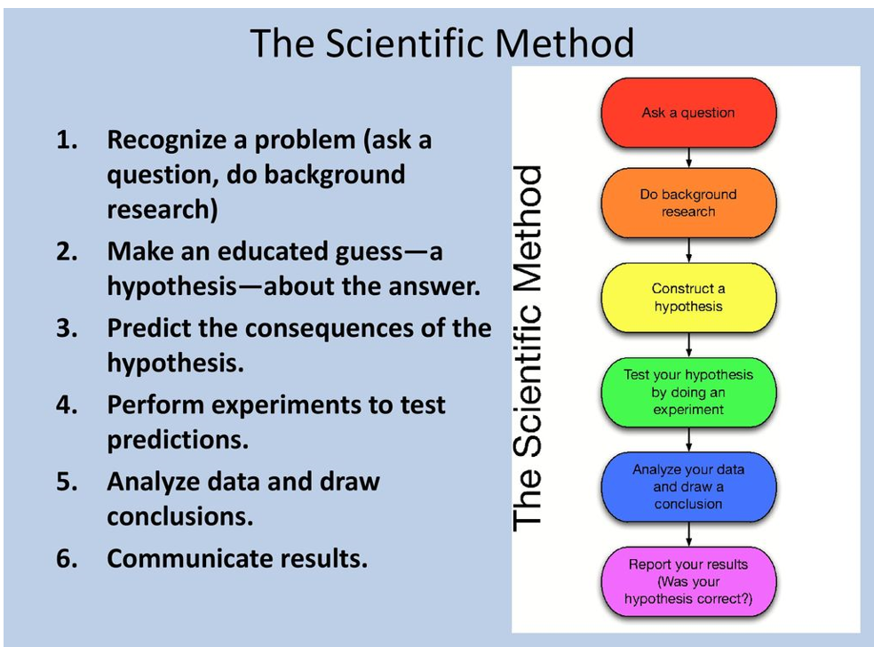

Slide 51
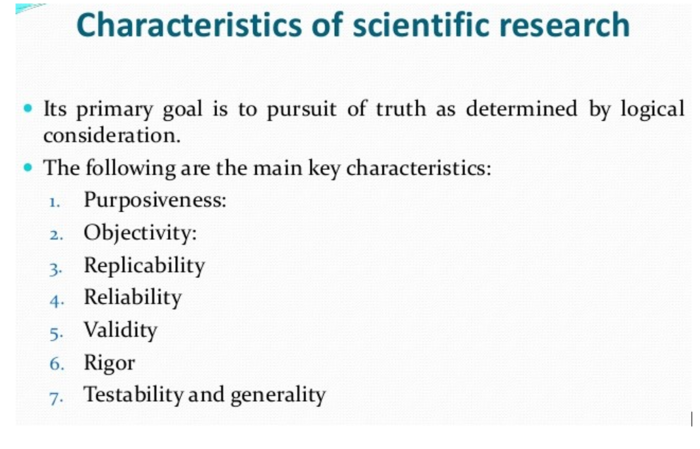

Slide 52
The scientific method is, thus, based on certain basic postulates which can be stated as under:
1. It relies on empirical evidence; 2. It utilizes relevant concepts; 3. It is committed to only objective considerations; 4. It presupposes ethical neutrality 5. It results into probabilistic predictions; 6. Its methodology is made known to all concerned for critical scrutiny are for use in testing the conclusions through replication;

Slide 53
Scientific Method
The use of a set of prescribed procedures for establishing and connecting theoretical statements about events and for predicting events yet unknown.

Slide 54
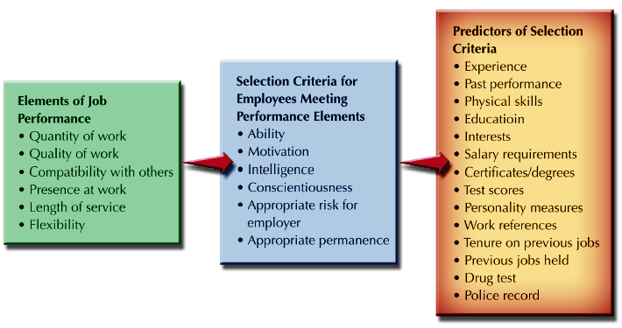
Empirical Evidence help us predict future reality through abstract concepts

Slide 55
Steps in Research Process Concept of Scientific Enquiry

Slide 56
RESEARCH PROCESS
FF
Review the literature
FF
Review
Concepts
And
theories
Design
Research
(Including
Sample
Design)
Analyse
Data
Formulate
hypothesis
Collect
Data
Interpret
and
report
Define
Research
Problem
Review
Previous
Research
findings
F
F
I
III
IV
V
VI
VII
II
F
F
Feed Back
FF
Feed Forward

Slide 57
The following order concerning various steps provides a useful procedural guideline regarding the research process:
Formulating the research problem;
Extensive literature survey; developing the hypothesis;
Preparing the research design;
Determining sample design; collecting the data;
Execution of the project;
Analysis of data;
Hypothesis testing;
Generalisations and interpretation, and
Preparation of the report or presentation of the results, i.E., Formal write-up of conclusions reached.

Slide 58
1. Formulating the research problem
A research problem is a definite or clear expression [statement] about an area of concern, a condition to be improved upon, a difficulty to be eliminated, or a troubling question that exists in scholarly literature, in theory, or within existing practice that points to a need for meaningful understanding and deliberate investigation.
A research problem does not state how to do something, offer a vague or broad proposition, or present a value question.

Slide 59
A Research problem is a question that a researcher wants to answer or a problem that a researcher wants to solve.
A research problem is an issues or a concern that an investigator / researcher presents and justifies in a research study
Selection of a research problem depends on several factors such as researcher’s knowledge, skills, interest, expertise, motivation & creativity with respect to the subject chosen.

Slide 60
A good research studies needs a lots of time for selection of research problem.
Initially every researcher faces a predicament of identifying, selecting and formulating a good research problem.

Slide 61
In others words, a research problem is an area of concern where there is a gap in the knowledge base needed for professional practices.
A research problem and problem statement are frequently used as synonyms.
However there are a lot of difference between them

Slide 62
SOURCES OF RESEARCH PROBLEM
The common sources of research problem are as follows.
1. Personal experience.
2. Practical experience.
3. critical appraisal of literature.
4.Previous research.
5. existing theories.
6. Social issues.
7. Brainstorming.
8. Exposure to field situation.
9. Consultation with experts

Slide 63
IDENTIFICATION OF RESEARCH PROBLEM
Identification of the research problem is the first step.
Generally a broad area is selected and then it is delimited or narrowed down to a specific one sentence statement of the problem.

Slide 64
PERSONAL EXPERIENCE
• Day to day experience of the researcher serves as a good source of ideas to formulate research problem.
PRACTICAL EXPERIENCE
• Clinical experience provides nurses ample opportunities for problem identification.
• This serves as a source for identifying research problems.
CRITICAL APPRAISAL OF LITERATURE
• When one looks at books, articles, summaries of clinical issues relating to the subject of our interest, pertinent questions may arise.

Slide 65
PREVIOUS RESEARCH
• A body of knowledge is developed on a sound research finding.
• Usually at the end of the research problems are suggested based on the shortcoming of the previous research, these could be investigated
EXISTING THEORIES
• Research is a process of theory development and theory testing.
If an existing theory is used in developing a researchable problem, a specific statement from theory must be isolated.
• Generally a part or parts of a theory are subjected to testing in a clinical situation.

Slide 66
The testing of a theory is needed therefore they serve as a good source of research problem.
SOCIAL ISSUES
• Sometimes issues of global contemporary or political issues of relevance are suggested.
• A idea for a research may stem from a familiarity with social concerns or controversial social issues
BRAINSTORMING
• Brainstorming sessions are good techniques to find new research questions.
Brainstorming refers to intensified discussions among interested people of the profession in order to find more ideas to formulate a good research problem.

Slide 67
Management Problems Mean Performance Gaps
Business performance is worse than expected business performance.
Actual business performance is less than possible business performance.
Expected business performance is greater than possible business performance.

Slide 68
Statement of Problem
Proposed research topic should have a genuine need for investigation.
Do the following need an investigation ?
High turn over of employees of a reputed five star hotel affecting its revenue.
An increasing trend of farmers’ suicides in a particular region.
Decelerating sales trend of a well known and popular automobile company affecting its sales revenue.
Yes
Notes:
68

Slide 69
RESEARCH PROBLEM
What is a research problem?
The term ‘problem’ means a question or issue to be examined.
.

Slide 70
HOW DO WE KNOW WE HAVE A RESEARCH PROBLEM?
Customer complaints
Conversation with company employees
Observation of inappropriate behaviour or conditions in the firm
Deviation from the business plan
Success of the firm’s competitor’s
Relevant reading of published material (trends, regulations)
Company records and reports.

Slide 71
SOURCES OF PROBLEMS
Reading
Academic Experience
Daily Experience
Exposure to Field Situations
Consultations
Brainstorming
Research

Slide 72
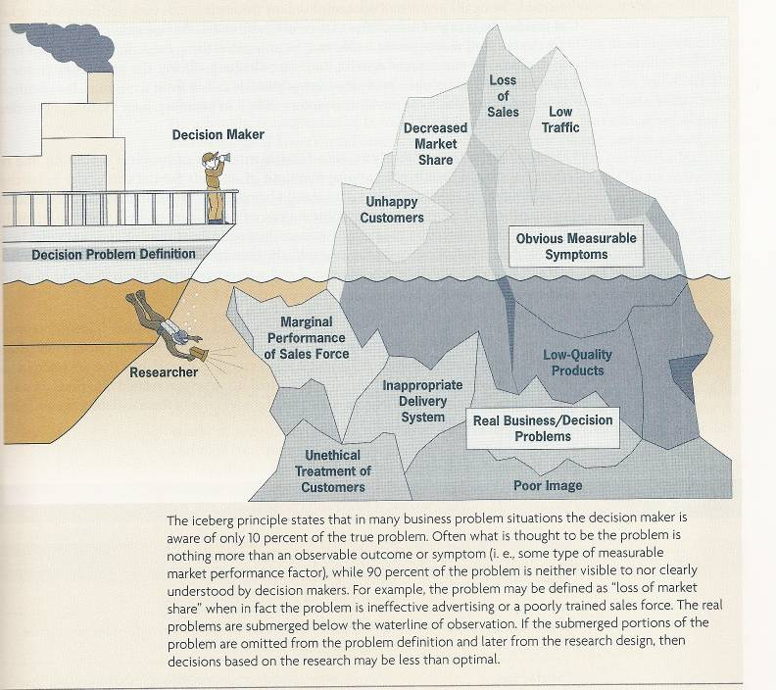

Slide 73
CRITERIA OF SELECTION
Factors
Internal / Personal criteria – Researcher’s Interest, Researcher’s Competence, Researcher’s own Resource: finance and time.
External Criteria or Factors – Research ability of the problem, Importance and Urgency, Feasibility, Facilities, Usefulness and Social Relevance, Research Personnel.

Slide 74
IDENTIFICATION / SELECTION OF THE RESEARCH PROBLEM
Identification / Selection of the Problem
Formulation of the Problem
There are two ways of stating a problem:
Posting question / questions
Making declarative statement / statements

Slide 75
Eg: Why is productivity in Japan so much higher than in India?
Brain storming
What sort of productivity is being referred?
What period?
Which sector?

Slide 76
Types of Research Questions and Results
What’s out there?
What does it look like?
How does it work?
How well does a method solve a problem?
Why does something happen the way it happens?
Predictive (Models): What would happen if --------------- ?
2008 © ChengXiang Zhai Dragon Star Lecture at Beijing University, June 21-30, 2008
76
Notes:
76

Slide 77
Research Idea
1. Job recruitment via the internet
2. Advertising and share prices
3. The future of trade unions
Research Question
1. How effective is recruiting for new staff via the internet in comparision with the traditional methods.
2.How does the running of a TV advertising campaign designed to boost the image of a company affect.
3. What are the strategies that trade unions should adopt to ensure their future viability?

Slide 78
The Process of Problem Definition
Ascertain the decision maker’s objectives
Determine research objectives
Understand background of the problem
Determine the unit of analysis
Isolate/identify the problem, not the symptoms
Determine relevant variables and state hypotheses

Slide 79
Ascertain the Decision Maker’s Objectives
Managerial objectives should be expressed in measurable terms; however, line managers seldom clearly articulate their problems to the researchers.
Researchers should try to understand the problems by interviewing the related managers and collect information from other sources.

Slide 80
Understand the Background of the Problem
Situation analysis: the informal gathering of background information to familiarize researchers or managers with the decision area.
The Iceberg Principle: the dangerous part of many business problems is neither visible to nor understood by managers.

Slide 81
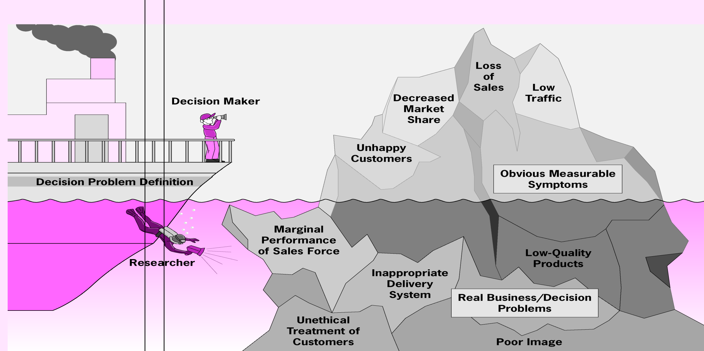

Slide 82
Isolate and Identify the Problems, Not the Symptoms
*Identify the Symptoms
by interrogative techniques: Asking multiple what, where, who, when, why, and how questions about what has changed.
by probing :An interview technique that tries to draw deeper and more elaborate explanations from the discussion.
*Isolate the Symptoms from the True Problem

Slide 83
Symptoms can be confusing
The case of twenty-year-old neighborhood swimming association:
Membership has been declining for years.
Maybe neighborhood residents prefer the expensive water park.

Slide 84
Organization | Symptoms | Problem Definition Based on Symptoms | True Problem
Twenty-year-old neighborhood swimming association in a major city. | Membership has been declining for years. New water park with wave pool and water slides moved into town a few years ago. | Neighborhood residents prefer the expensive water park and have negative image of swimming pool. | Demographic changes: Children in this 20-year-old neighborhood have grown up. Older residents no longer swim anywhere.
Beverage manufacturer | Consumers prefer taste of competitor’s products | Taste of our product needs to be reformulated | Old fashioned package is influencing consumers’ taste perceptions.

Slide 85
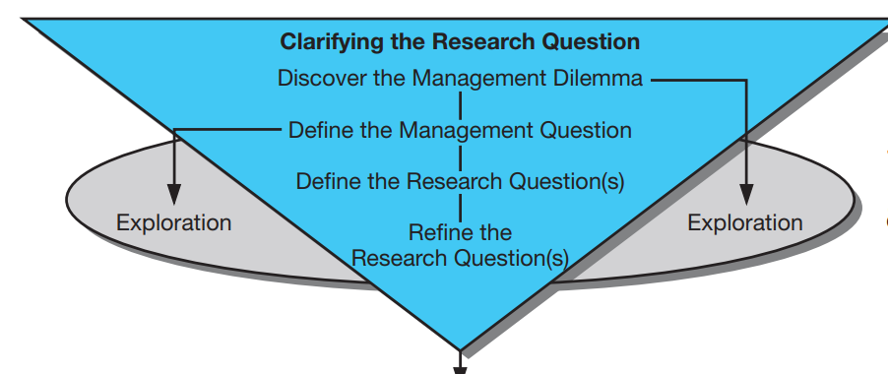

Slide 86


Slide 87
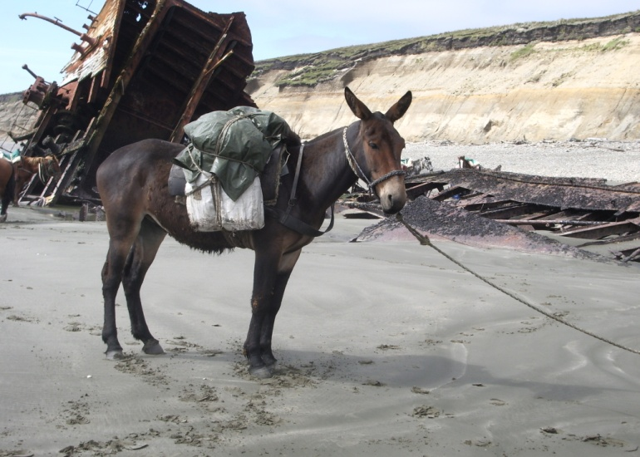

What Language Is Written on This Stone Found by Archaeologists?
The Language is English: “to tie mules to”

Slide 88
2. Extensive literature survey

Slide 89
REVIEW OF LITERATURE
It is an extensive survey of all available past studies relevant to the field of investigation.
It gives us knowledge about what others have found out in the related field of study and how they have done so.

Slide 90
PURPOSE OF REVIEW
To gain a background knowledge of the research topic.
To identify the concepts relating to it, potential relationships between them and to formulate researchable hypothesis.
To identify appropriate methodology, research design, methods of measuring concepts and techniques of analysis.
To identify data sources used by other researchers.
To learn how others structured their reports.

Slide 91
SOURCES OF LITERATURE
Books and Journals
Electronic Databases
Bibliographic Databases
Abstract Databases
Full-Text Databases
Govt. and Industry Reports
Internet
Research Dissertations / Thesis

Slide 92
Points to be kept in mind while reviewing literature..
Read relevant literature.
Refer original works.
Read with comprehension.
Read in time.
Index the literature.

Slide 93
3. HYPOTHESIS DEVELOPMENT
Research Hypothesis is a predictive statement that relates an independent variable to a dependant variable.
Hypothesis must contain at least one independent variable and one dependant variable.

Slide 94
In most types of research, the development of working hypothesis plays an important role.
Hypothesis should be very specific and limited to the piece of research in hand because it has to be tested.
The role of the hypothesis is to guide the researcher by delimiting the area of research and to keep him on the right track.
It sharpens his thinking and focuses attention on the more important facets of the problem.
It also indicates the type of data required and the type of methods of data analysis to be used.

Slide 95
Propositions
Propositions are statements concerned with the relationships among concepts.
A hypothesis is a proposition that is empirically testable. It is an empirical statement concerned with the relationship among variables.
A variable is anything that may assume different numerical values.

Slide 96
Hypothesis
An supported proposition to answer a research question to be tested by research
H1: Decline in the purchasing power of the clients decreases the total sales of the industry.
H2: New designs increase customer satisfaction.

Slide 97
4. Preparing the research design
A detailed blueprint specifying how the research will be carried out
Description / location of the study area.
Selection of company / enterprise.
Data source.
Selection of quantitative parameters.
Selection of qualitative parameters.
Selection of respondents.
Data collection instrument.
Respondents contact method.
Data analytical tool.
Scope of the study.
Duration of the study.
Notes:
97

Slide 98
The research problem having been formulated in clear cut terms, the researcher will be required to prepare a research design.
research design is to provide for the collection of relevant evidence with minimal expenditure of effort, time and money.

Slide 99
5. Determining sample design:
All the items under consideration in any field of inquiry constitute a ‘universe’ or ‘population’.
A complete enumeration of all the items in the ‘population’ is known as a census inquiry.
The researcher must decide the way of selecting a sample or what is popularly known as the sample design.
In other words, a sample design is a definite plan determined before any data are actually collected for obtaining a sample from a given population.

Slide 100
Basic definitions
Population - Collection of all the units that are of interest to the investigator
Sample - Representative part of population
Sampling - Technique of selecting a representative group from a population
Characteristic of good sample design
True representation of population
May result in small sampling error
Each member in population should get an opportunity of being selected
Systematic bias can be controlled in a better way
Results should be capable of being extrapolated

Slide 101
Types of sample design
Probability/Random sampling - Selection of subjects are according to any predicted chance of probability
Non-probability/non-random sampling - Does not depend on any chance of predecided probability

Slide 102
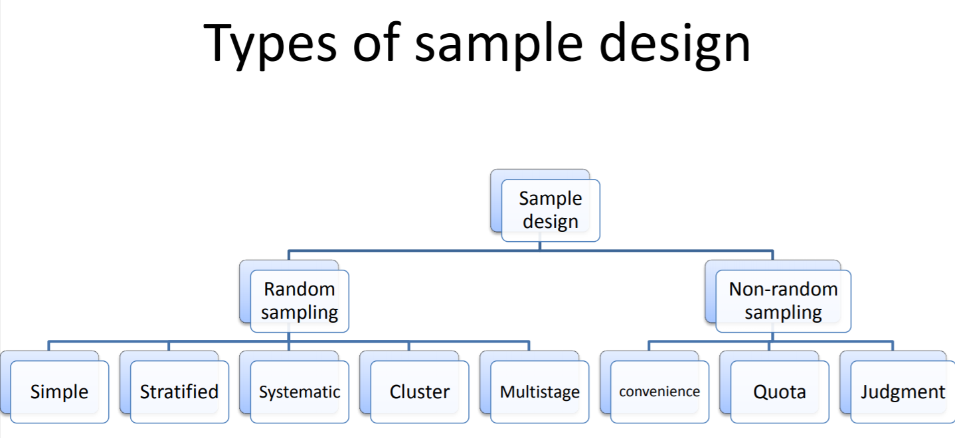

Slide 103
Collecting the data:
In dealing with any real life problem it is often found that data at hand are inadequate, and hence, it becomes necessary to collect data that are appropriate.
There are several ways of collecting the appropriate data which differ considerably in context of money costs, time and other resources at the disposal of the researcher

Slide 104
By observation
Through personal interview
Through telephone interviews
By mailing of questionnaires
Through schedules

Slide 105
8. Analysis of data
Coding
Editing
Tabulation

Slide 106
9. Hypothesis-testing
After analysing the data as stated above, the researcher is in a position to test the hypotheses.
Various tests, such as Chi square test, t-test, F-test, have been developed by statisticians for the purpose.
The hypotheses may be tested through the use of one or more of such tests, depending upon the nature and object of research inquiry

Slide 107
Hypothesis
An unsupported proposition to answer a research question to be tested by research
H1: Decline in the purchasing power of the clients decreases the total sales of the industry.
H2: New designs increase customer satisfaction.

Slide 108
10. Generalisations and interpretation:
If a hypothesis is tested and upheld several times, it may be possible for the researcher to arrive at generalisation, i.e., to build a theory.

Slide 109
11. Preparation of the report or the thesis
Finally, the researcher has to prepare the report of what has been done by him.

Slide 110
Components of Research
Title
Introduction
Statement of the Problem
Review of Literature
Objectives of the Study
Hypotheses for the Study
Research Design and Methodology
Conceptual Framework
Report Writing and Implications of the Study
Conclusion
Select Bibliography
Notes:
110

Slide 111

Thank You
Stay @home and stay Safe

